Slide 1

Modelling Interest rate
Harpreet Singh

Slide 2
OUTLOOK
1
2
3
Overall
Data preprocessing.
Distribution fitting
Involves data cleaning and stationing.
Here, we will look at bunch of probability distribution functions and see which fits best to our data.
4
5
PCA
Vasicek model
Search for Principal Components that describe our multi-dimensional data.
Extracting Vasicek model parameters and simulating future short rates based on them,

Slide 3
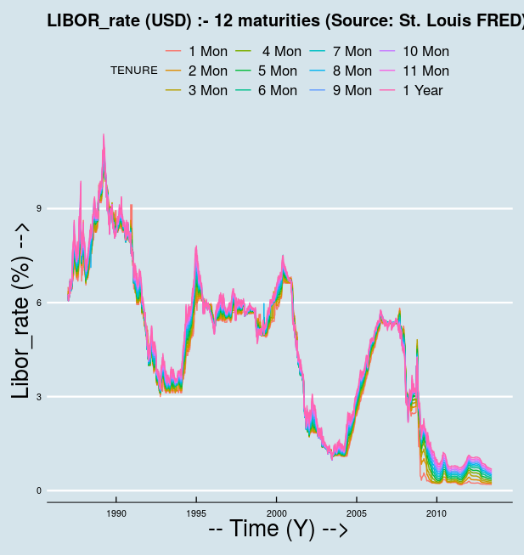
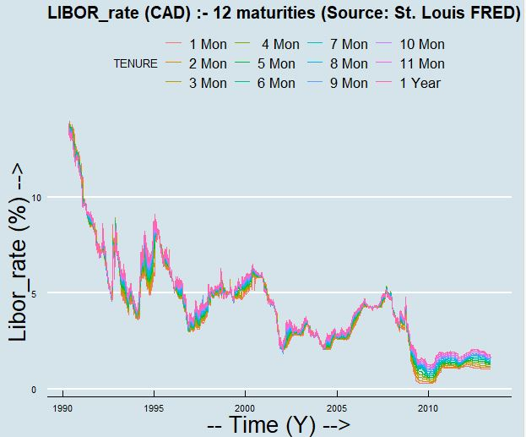
Overall: (30_year_plot)

Slide 4
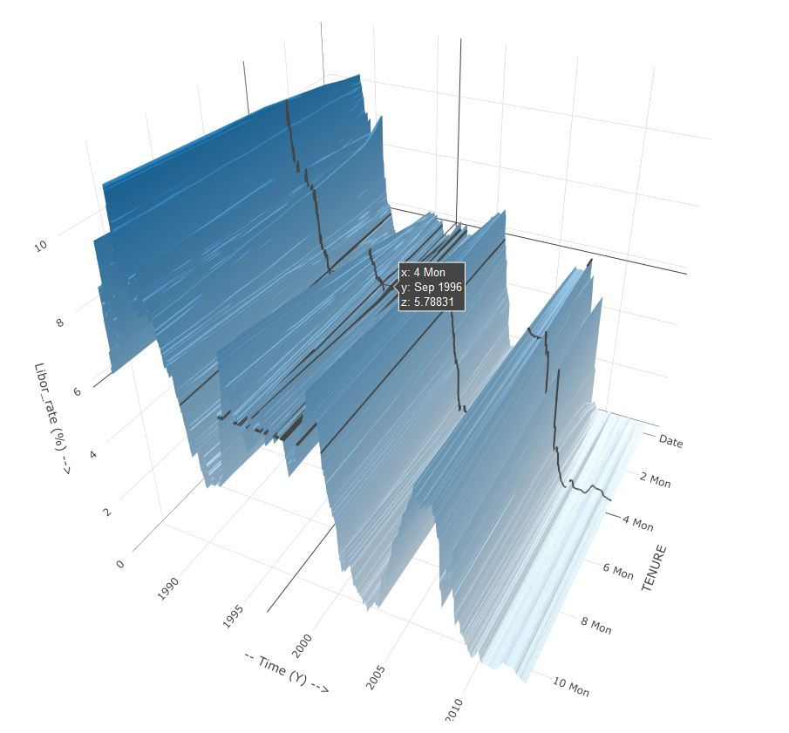
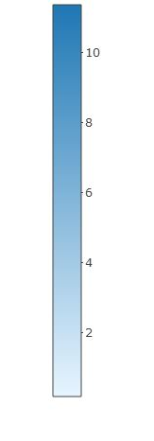
Overall: (3D_plot)

Slide 5
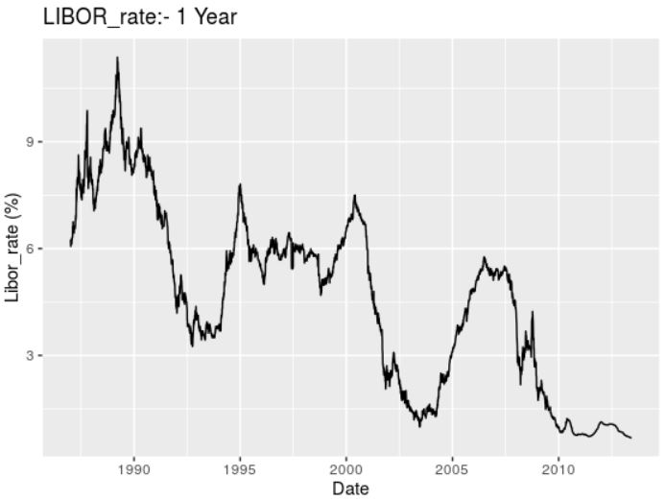
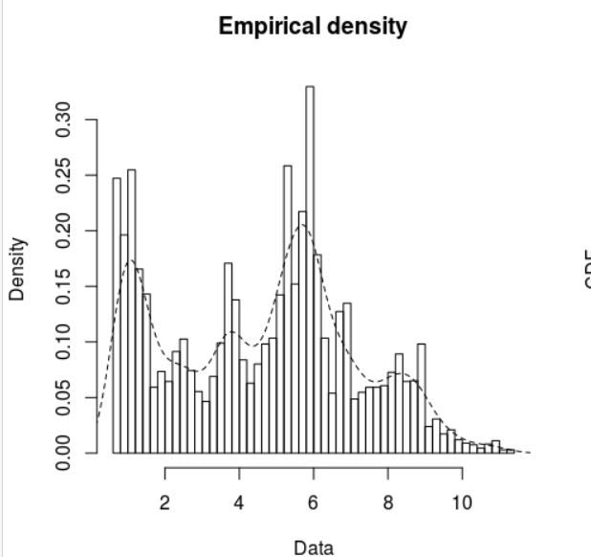
Overall: USD_1_Year (Histogram)

Slide 6
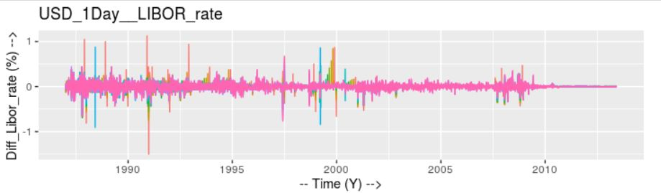
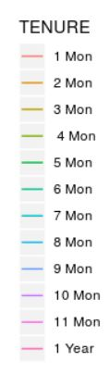
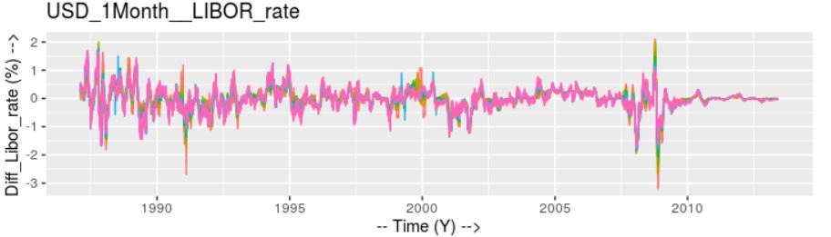
Data_preprocessing: Stationing.

Slide 7
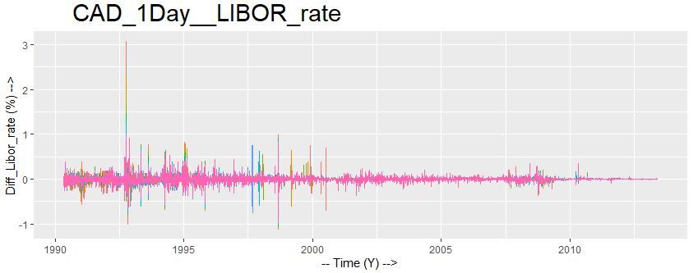
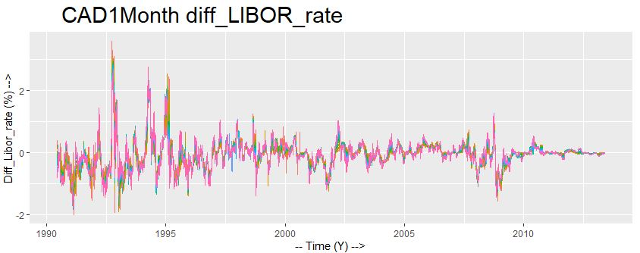
Data_preprocessing: Stationing.

Slide 8
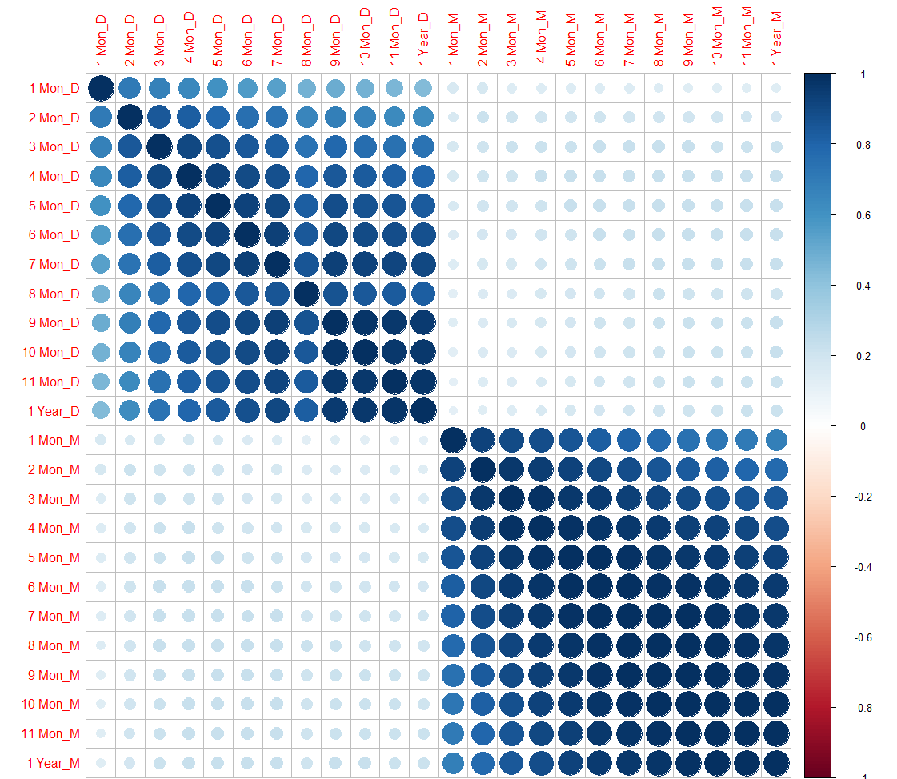
Data_preprocessing: USD corrplot.

Slide 9
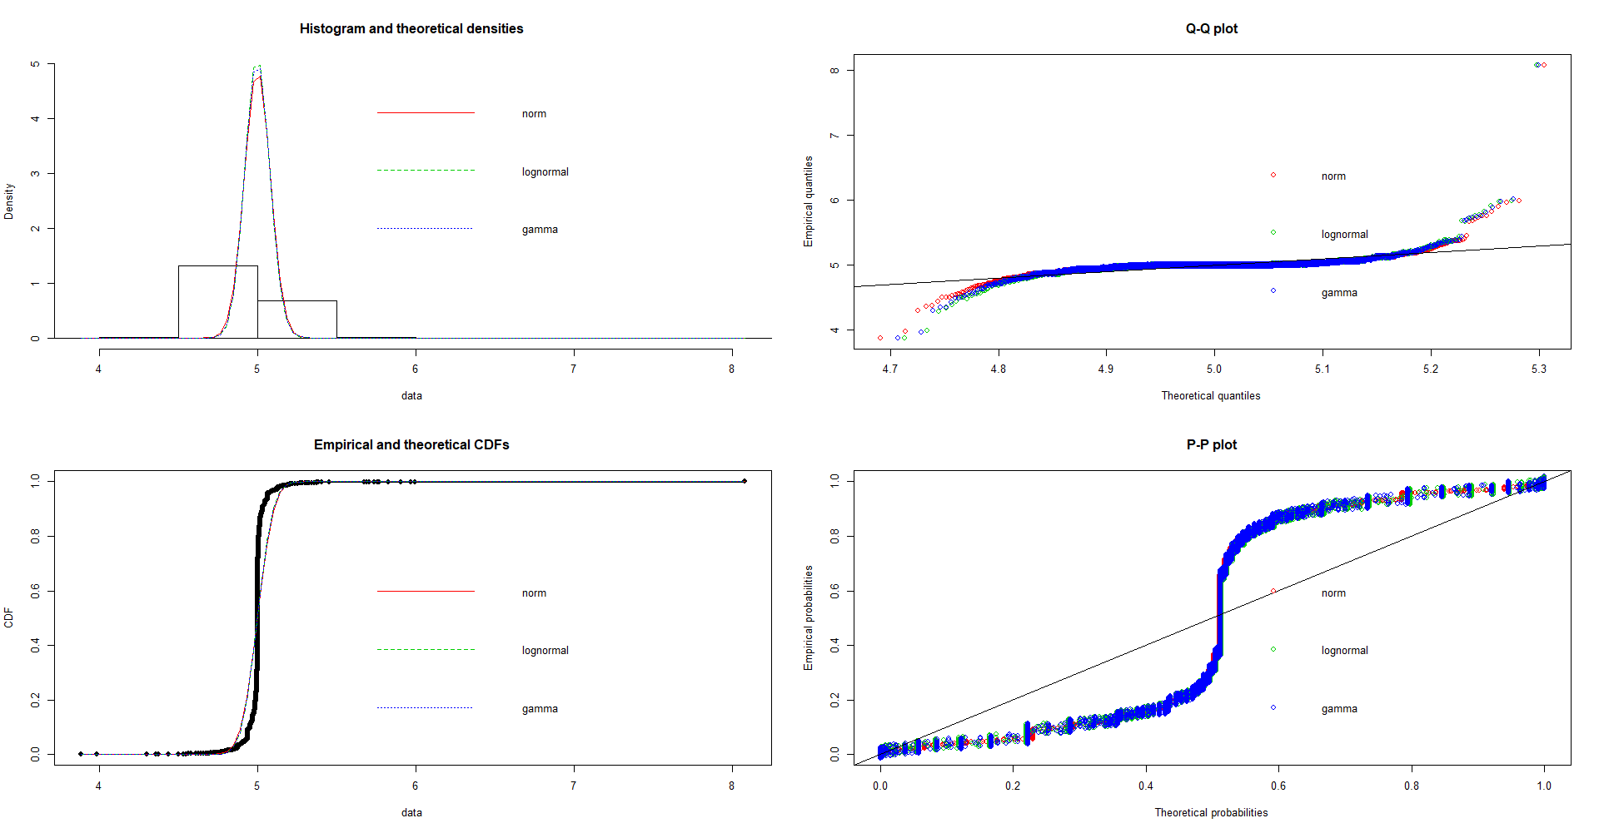

Distribution Fitting: 1Day (norm,lognorm,gamma)

Slide 10
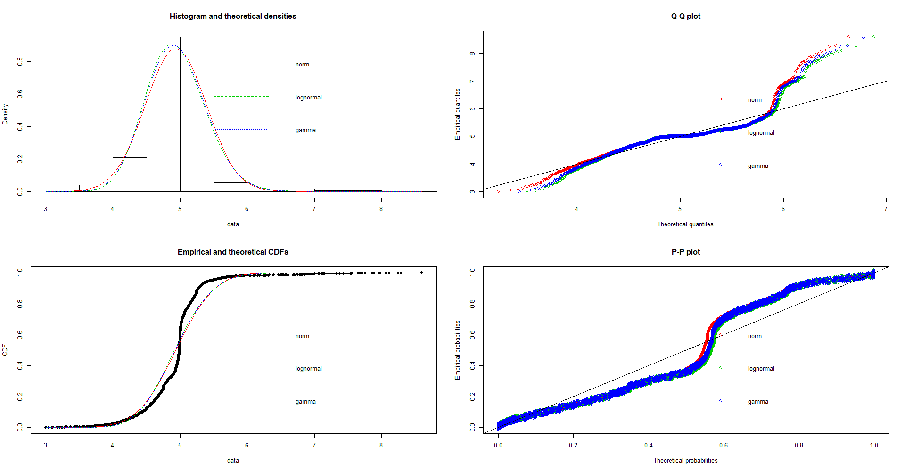

Distribution Fitting: 1Month (norm,lognorm,gamma)

Slide 11
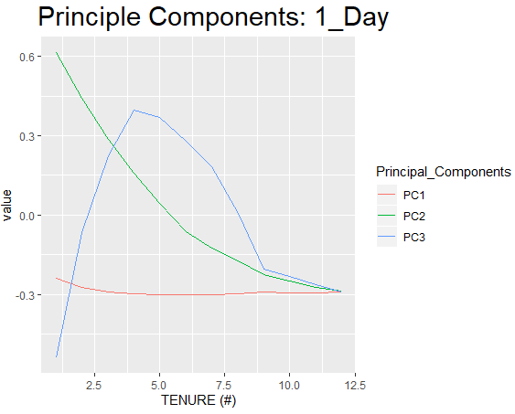
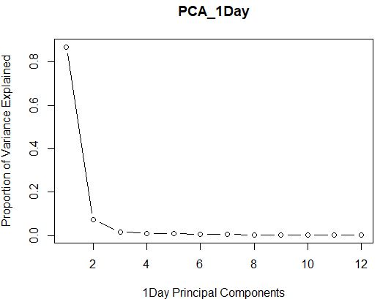
PCA:1Day (USD)

Slide 12
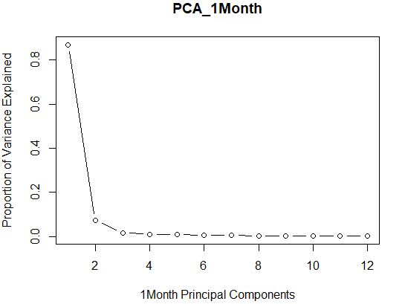
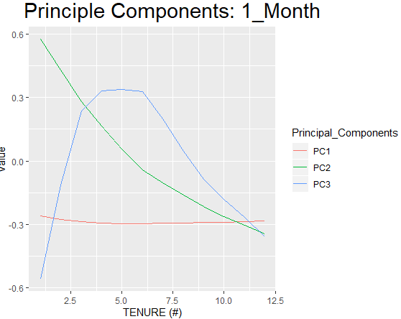
PCA:1Month (USD)

Slide 13
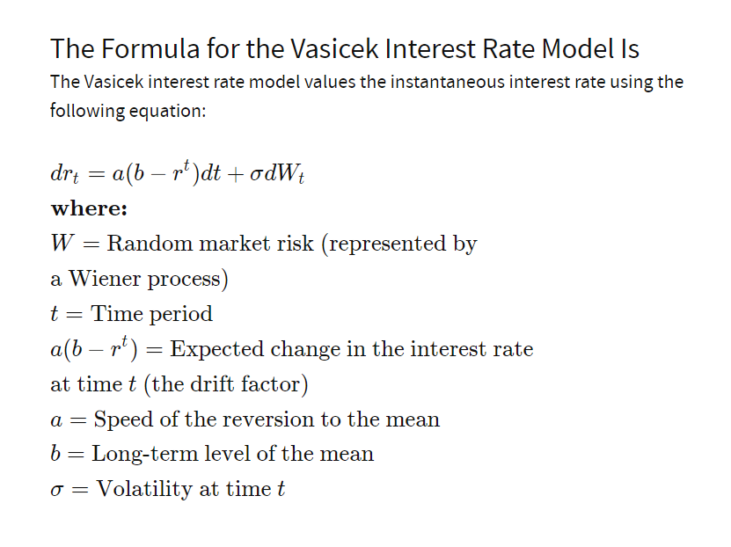
Vasicek Model:

Slide 14
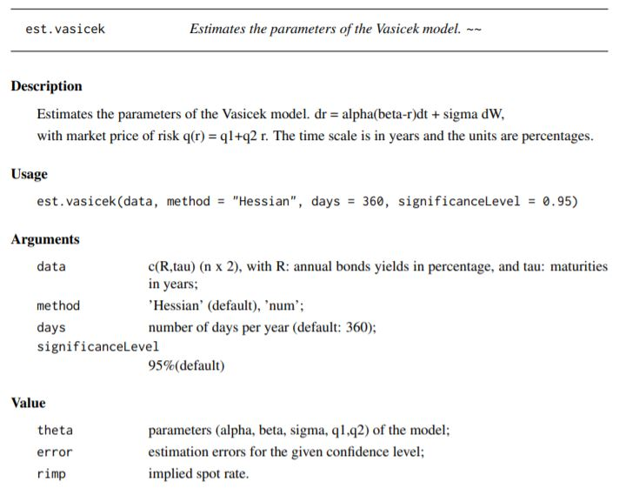
Vasicek Model: Parameter_estimation (library("SMFI5"))

Slide 15
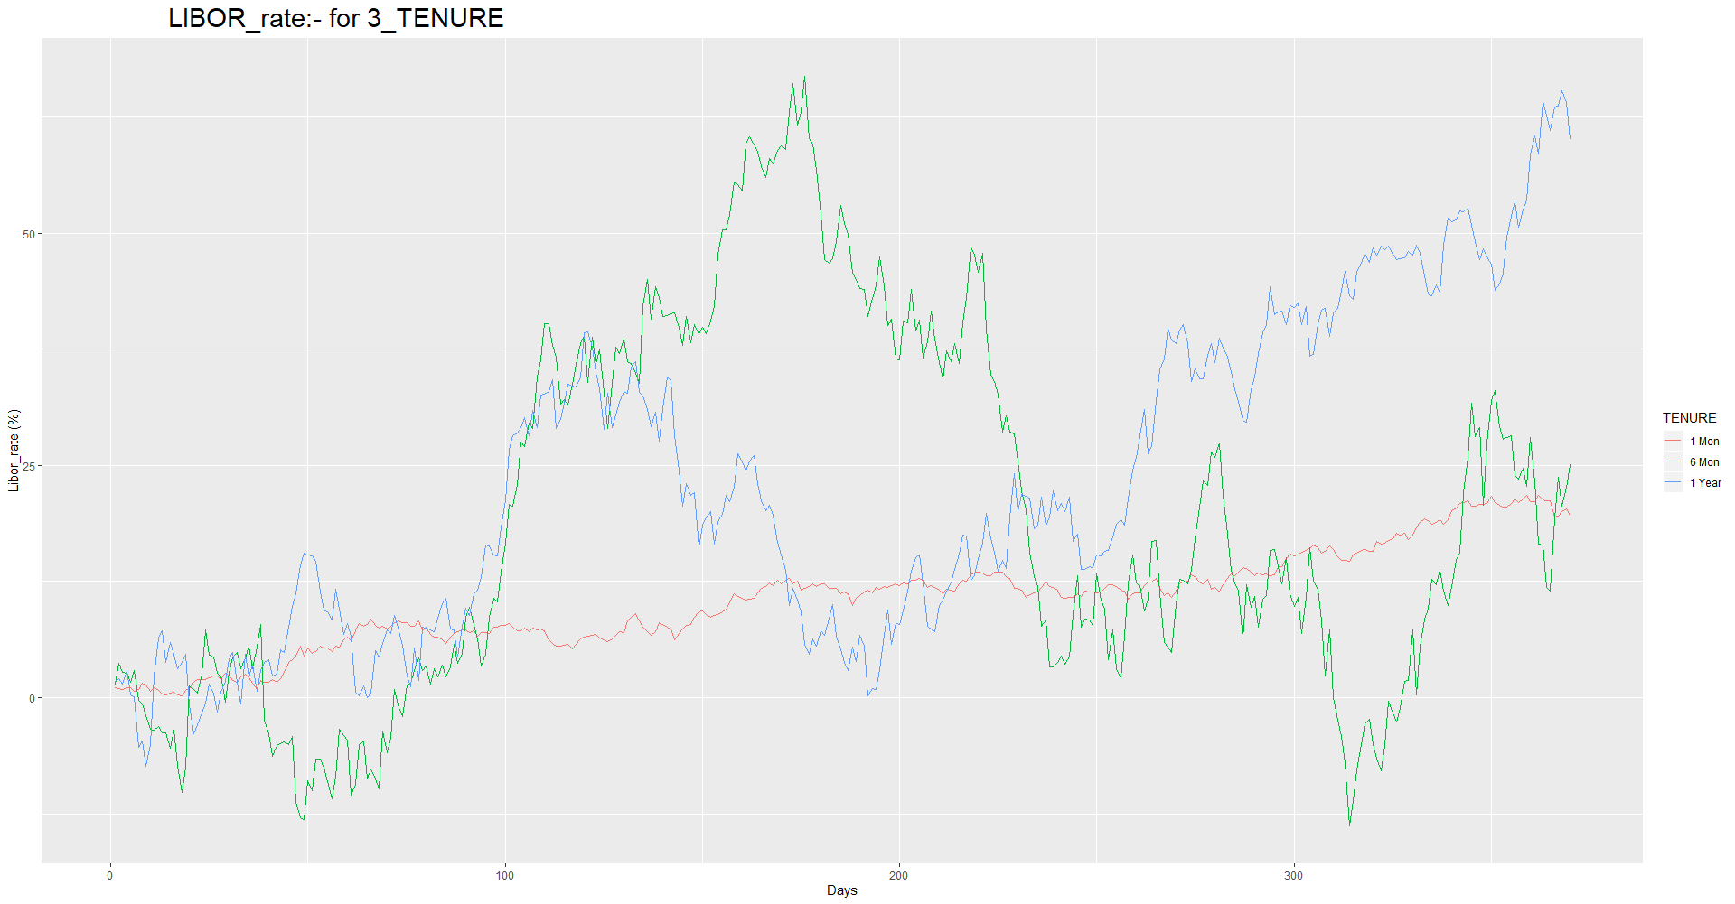
Vasicek Model: Simulation

Slide 16
Thank you

